Slide 1
CS595—Big Data Technologies
Module 09
Hadoop Data Ingestion
Apache Sqoop

Slide 2
What is Sqoop?
Designed for efficiently transferring bulk data between Hadoop and data stores such as relational databases
Imports data from external data stores into HDFS, Hive and HBase.
Exports data from Hadoop to data stores such as relational databases

Slide 3
Why Sqoop?
As more organizations deploy Hadoop to analyze streams of information…
They may find they need to transfer large amount of data between Hadoop and their existing databases…
And transferring data using scripts is a inefficient and time-consuming task
Hadoop is great for storing massive data in terms of volume using HDFS
But it’s Batch-Oriented and thus not suitable for low latency interactive query operations
Sqoop is an ETL Tool used to copy data between HDFS and SQL databases
Import SQL data to HDFS for archival or analysis
Export HDFS to SQL ( e.g : summarized data used in a DW fact table )

Slide 4
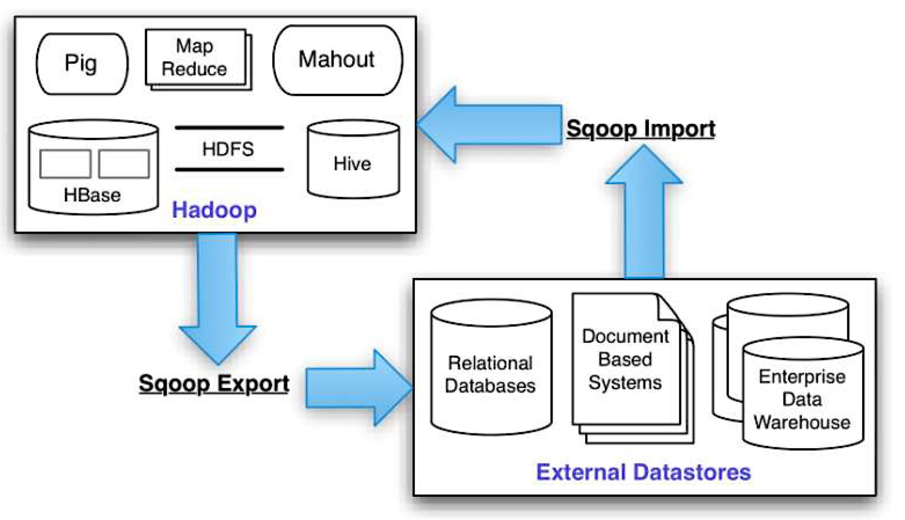
Sqoop Landscape

Slide 5
Sqoop Architecture
Sqoop
RDBMS
Mapper
Mapper
Mapper
Mapper
HDFS or
Hive

Slide 6
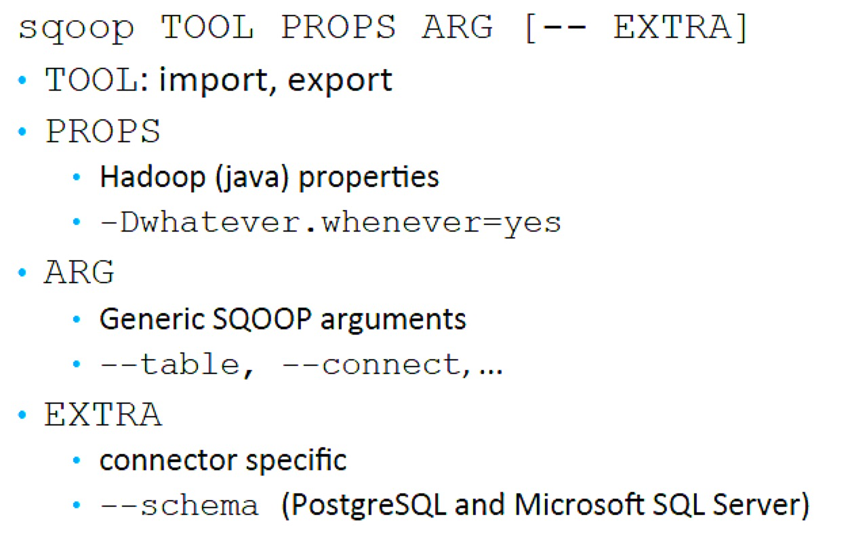
SQOOP Command Line

Slide 7
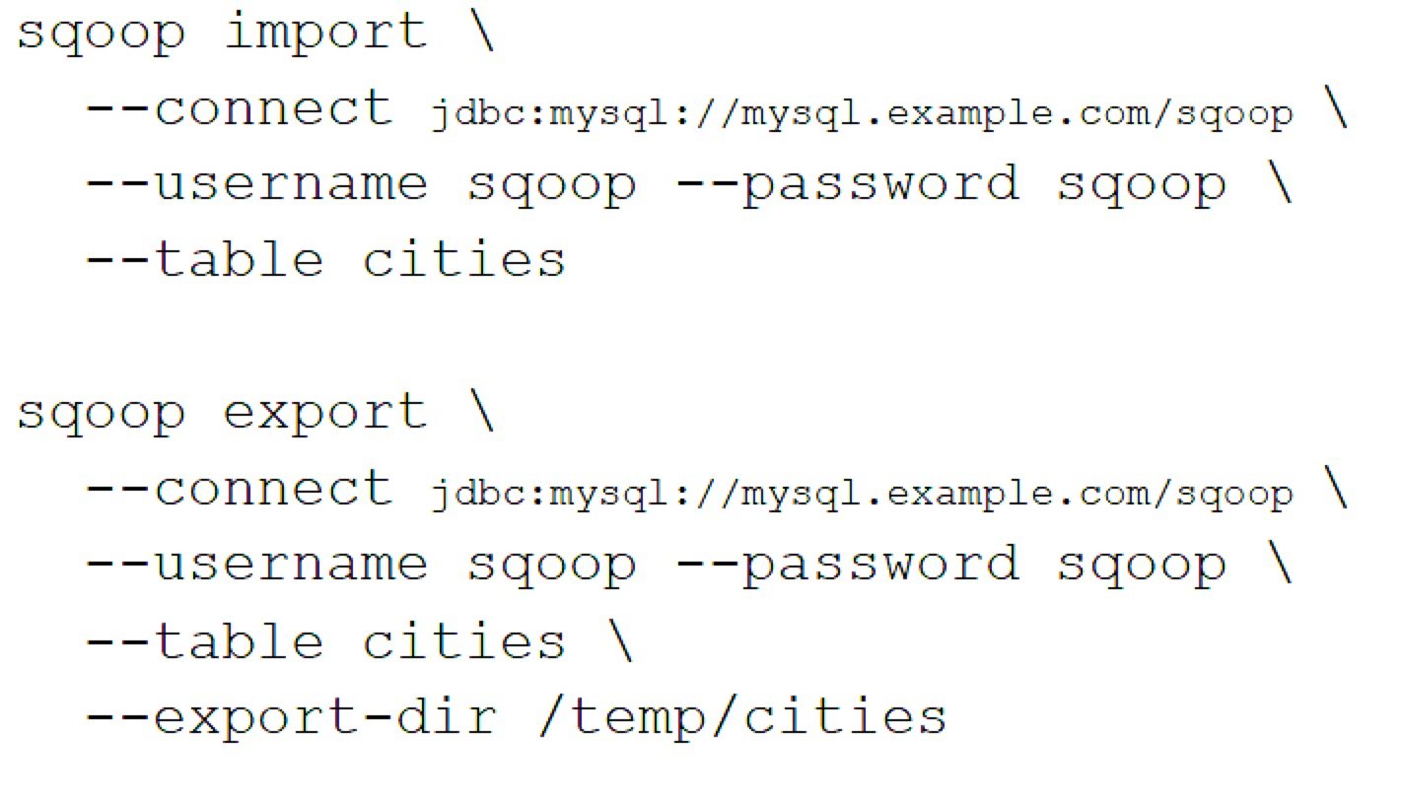
SQOOP Examples

Slide 8
Transferring an Entire Table
You have a table in a relational database (e.g., MySQL) and you need to transfer the table’s contents into HDFS
Importing one table with Sqoop is very simple
You issue the Sqoop import command and specify the database credentials and the name of the table to transfer
sqoop import \
--connect jdbc:mysql://mysql.example.com/sqoop \
--username sqoop \
--password sqoop \
--table cities

Slide 9
Transferring an Entire Table
The result of this command will be a comma-separated CSV file where each row is stored in a single line
1,USA,Palo Alto
2,Czech Republic,Brno
3,USA,Sunnyvale
By default, Sqoop will create a directory with the same name as the imported table inside your home directory on HDFS and import all data there
For example, when the user jarcec imports the table cities, it will be stored in /user/jarcec/cities
The only requirement is that this directory must not exist prior to running the Sqoop command

Slide 10
Specifying a Target Directory
Use the --target-dir parameter to specify the directory on HDFS where Sqoop should import your data
For example, use the following command to import the table cities into the directory /etl/input/cities
sqoop import \
--connect jdbc:mysql://mysql.example.com/sqoop \
--username sqoop \
--password sqoop \
--table cities \
--target-dir /etl/input/cities

Slide 11
Specifying a Target Directory
To specify the parent directory for all your Sqoop jobs, use the --warehouse-dir parameter
sqoop import \
--connect jdbc:mysql://mysql.example.com/sqoop \
--username sqoop \
--password sqoop \
--table cities \
--warehouse-dir /etl/input/
Here the table data will be stored under the directory:
/etl/input/cities

Slide 12
Importing Only a Subset of Data
Instead of importing an entire table, to transfer only a subset of the rows based on various conditions…
You can express in the form of a SQL statement with a WHERE clause
Use the command-line parameter --where to specify a SQL condition that the imported data should meet
sqoop import \
--connect jdbc:mysql://mysql.example.com/sqoop \
--username sqoop \
--password sqoop \
--table cities \
--where "country = 'USA'"

Slide 13
Protecting Your Password
Typing your password into the command-line interface is insecure
It can be retrieved from listing the operating system’s running processes
You have two options besides specifying the password on the command line with the --password parameter
The first option is to use the parameter -P that will instruct Sqoop to read the password from standard input
Or, you can save your password in a file and specify the path to this file with the parameter --password-file

Slide 14
Importing All Your Tables
You would like to import all tables from your database at once using one command rather than importing the tables one by one…
Rather than using the import tool for one table, you can use the import-all-tables tool
sqoop import-all-tables \
--connect jdbc:mysql://mysql.example.com/sqoop \
--username sqoop \
--password sqoop

Slide 15
Importing All Your Tables
If you need to import all but a few tables, you can use the parameter --exclude-tables
This accepts a comma-separated list of table names that should be excluded from the import
For example, if you need to import all tables from the database except cities and countries:
sqoop import-all-tables \
--connect jdbc:mysql://mysql.example.com/sqoop \
--username sqoop \
--password sqoop \
--exclude-tables cities,countries

Slide 16
Transferring Data from Hadoop
You have a workflow of various Hive and MapReduce jobs that are generating data on a Hadoop cluster
And you need to transfer this data to your relational database
You can use Sqoop’s export feature that allows you to transfer data from the Hadoop ecosystem to relational databases
To export data from the HDFS export-dir directory cities into the database table cities
sqoop export \
--connect jdbc:mysql://mysql.example.com/sqoop \
--username sqoop \
--password sqoop \
--table cities \
--export-dir cities

Slide 17
Exporting into a Subset of Columns
You have data in Hadoop that you need to export
But the corresponding table in your database has fewer columns than the HDFS data
You can use the --columns parameter to specify which columns (and in what order) are present in the Hadoop data to export
For example, to limit the export to columns country and city, use the following command
sqoop export \
--connect jdbc:mysql://mysql.example.com/sqoop \
--username sqoop \
--password sqoop \
--table cities \
--columns country,city

Slide 18
Sqoop Information
http://sqoop.apache.org/

